Slide 1
Linear Regression Part IV: Handling Violations of Assumptions
Dr. Upender Subramanian
MKT / BUAN 6337

Slide 2
Regression is a powerful tool for forecasting. Economists using it successfully predicted ten out of the last two recessions.
- Christopher Doyle‏

Slide 3
Common Violations of Linear Regression Assumptions
Outliers and Influential observations
Multicollinearity amongst independent variables
Heteroscedasticity in error term
Normality of error term

Slide 4
Outliers and Influential observations
We would like the model to not be sensitive to dropping one / few observations
We want model results to be based on entire data, not a small fraction
Otherwise, model can be biased / not representative of true relation
Outliers (large residual): extreme values of Y that cause residuals to be high, resulting in poor fit or over-influencing regression estimates
Possible to identify even before regression is estimated
Influential points (large leverage): extreme values of X or Y that have undue influence on regression estimates
Typically identifiable only after regression is estimated

Slide 5
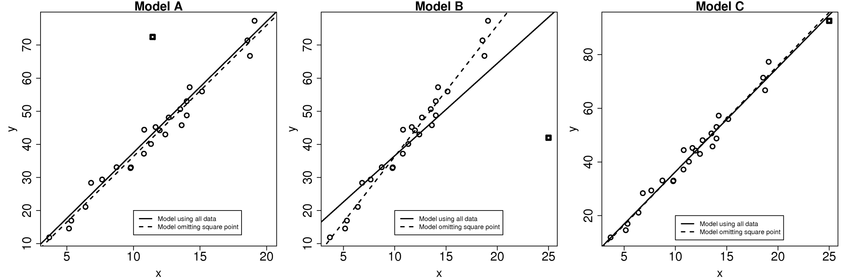
Outliers and Influential Points
OLS Regression => chooses coefficients that minimize squared deviation from predicted values
A single large deviation can unduly influence choice of estimates

Slide 6
Outliers and Influential Points
Cook’s D: measure of influence of each observation, effect of deleting that observation on regression estimates
Thumb rule: Observations with D > 4/n should be inspected
What can be done
Omit points => can introduce bias, tempting to drop points that weaken hypothesis
Robust regression – without dropping points, use alternate assumptions to estimate model
Estimation methods: M, LTS, MM
MM is good for outliers and influential points
Assigns lower weightage to influential points
Conducts weighted OLS regression

Slide 7
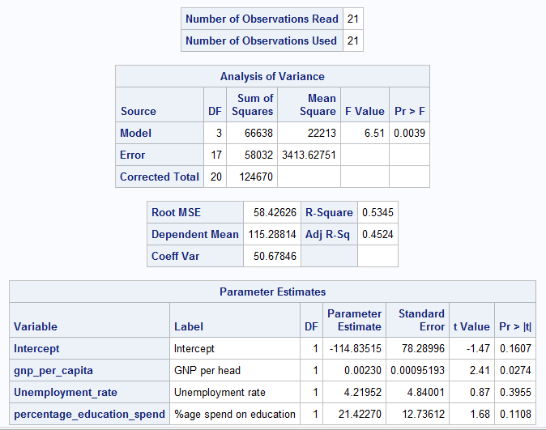
Recall Computer Sales Example
Coefficient for unemployment rate is positive!!

Slide 8
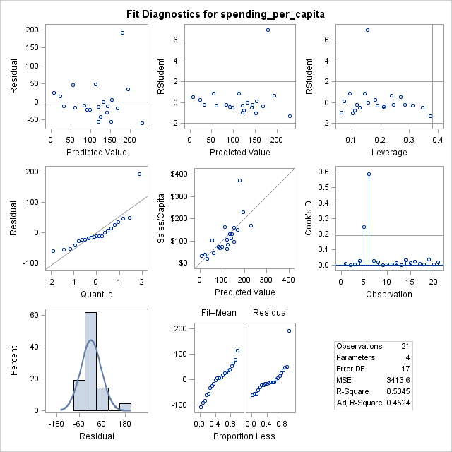
Regression Diagnostics

Slide 9
Regression Omitting Outlier

Slide 10
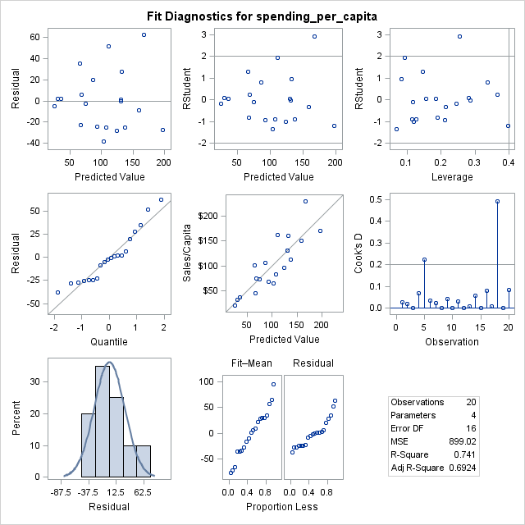
Diagnostics Omitting Outlier

Slide 11
Robust Regression (MM)

Slide 12
Multicollinearity
X1 is related to X2 and X3
Highly correlated, or
Linearly dependent
Estimated variances of coefficients become large => low t values => fail to reject H₀ that coefficient is zero.
Common convention is to drop variables with highly insignificant estimates
However, highly insignificant estimates may be a result of Multicollinearity (MC)
Signs of coefficients could be incorrect.
Results are sensitive to deletion of a single row.

Slide 13
Multicollinearity Detection
Check all pairwise correlations for independent variables.
Check VIF (variance inflation factor)
If VIF>10 for a variable there could be multicollinearity
Check principal components for collinearity amongst variables
If largest condition index is ~10, MC can have weak effect on estimates
If largest condition index is > 100, MC can have fair effect
If principal component with high index contributes to high proportion of variance of multiple variables, MC causes a problem

Slide 14
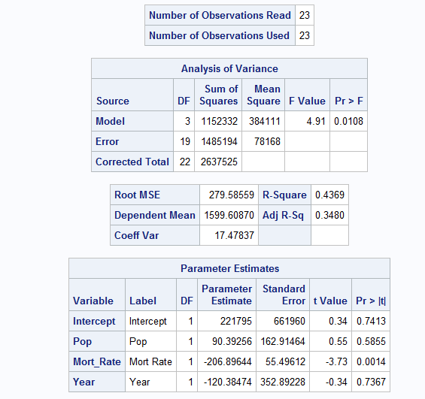
Example: Housing Data
Problems
Pop and Year are not significant
Negative coefficient of Year does not make sense.

Slide 15
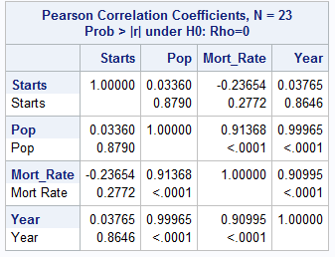
Correlation Matrix
The reason
High correlation between Pop and Year
High correlation between Mort_Rate
and Year
Notes:
Next Step – Drop ‘Year’ and re-estimate the model

Slide 16
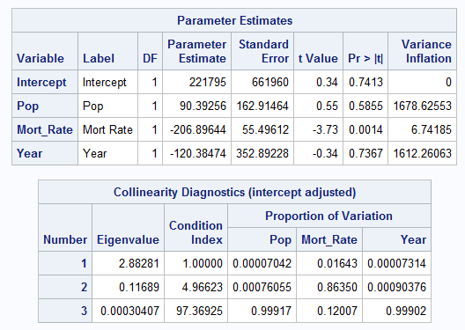
Regression Diagnostics

Slide 17
Handling Multicollinearity
Collect more data – where there is independent variation amongst the independent variables
Especially if multicollinearity involves main variable(s) of interest
Drop one or more variables to minimize or avoid multicollinearity (as indicated by regression diagnostics)
Can no longer uniquely interpret coefficients
Use principal component analysis to create non-collinear variables (through linear combinations of original variables)
Better approach than (2), interpretation can be difficult

Slide 18
Heteroscedasticity
Regression Assumption: Error term has the same variance across all observations
This need not hold in many applications
E.g., variance in purchases higher for large (>$500) than small ($<100) purchases
E.g., variance in sales lower for large firms than for small firms
p-values for coefficients are then incorrect
Estimates for coefficient are still correct

Slide 19
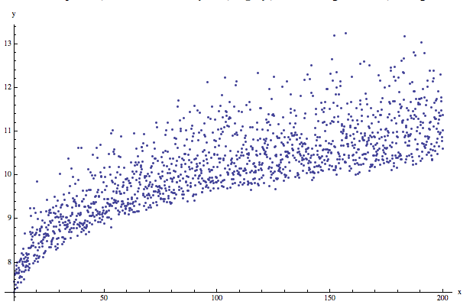
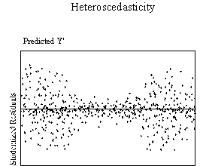
Heteroscedasticity Detection
Formal Test: Conduct White’s test
Plot standardized residuals against predicted Y.
If the variance of the residuals increases or decreases with a corresponding increase in predicted Y then there is heteroscedasticity

Slide 20
Solutions
Transform Y variable using a log function / square root function or the inverse of Y to mitigate the problem.
That is, use log(Y) or sqrt(Y) as dependent variable.
Transformation often works because it reduces the spread in the dependent variable (check for yourself!)
Use (heteroscedasticity) robust standard errors
Pros: This is a method that “fixes” the incorrect standard errors, and as a result the p values are correct.
Cons: Often creates large S.E and therefore large confidene intervals
Could indicate segments - include additional independent variable terms (incl. interactions) to explain variation
Notes:
But (1) might overcorrect
Weighted Least Square – different approach to handle heteroscedasticity – depending on where (which variable) the variance is coming from.
If variance of residual is proportional to X1^2 (then divide by X1).
PROC REG;
WEIGHT A; (A defined as 1 / X)
MODEL Y = X1 / WHITE SPEC;
RUN;

Slide 21
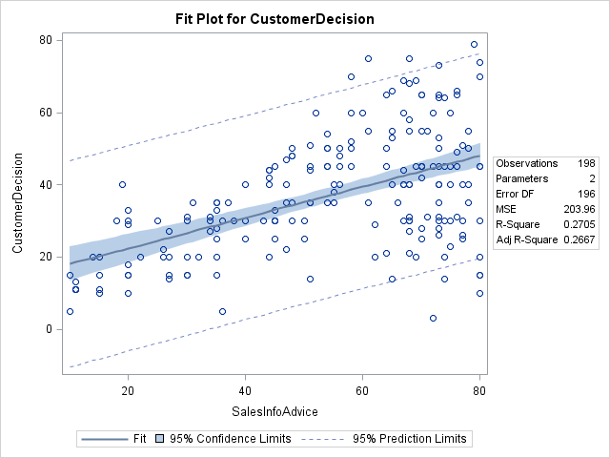
Sales Experiment Example
CustomerDecision = A + B*SalesInfoAdvice

Slide 22
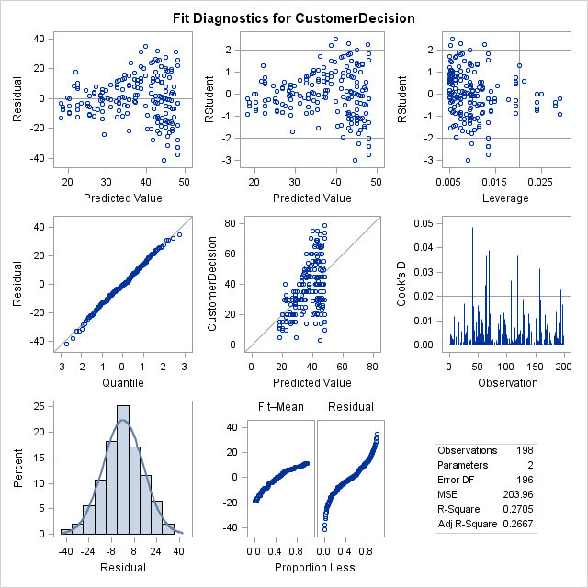
Sales Experiment Example

Slide 23
Robust Standard Errors

Slide 24
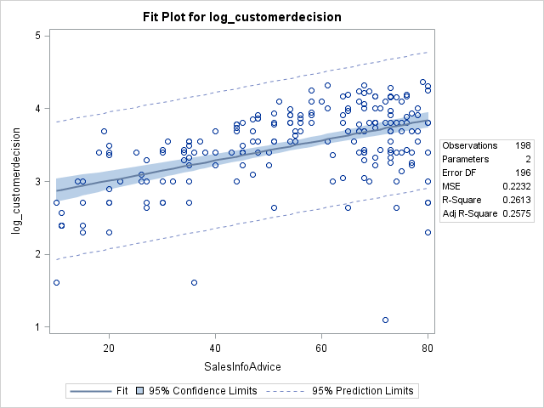
Variable Transformation
Log(CustomerDecision) = A + B*SalesInfoAdvice

Slide 25
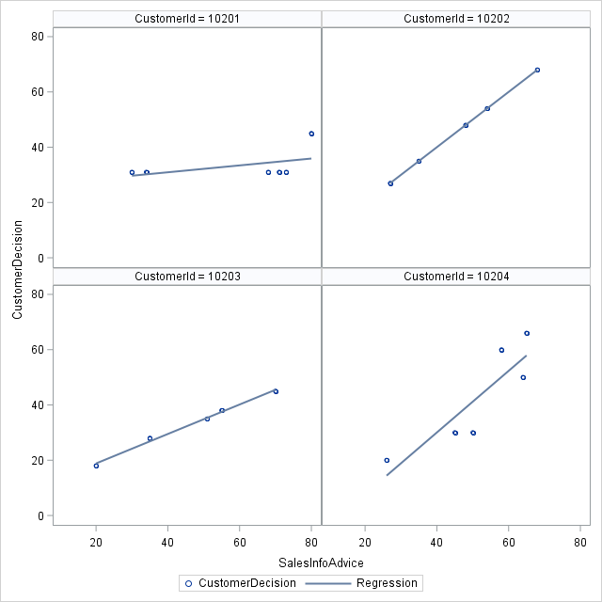
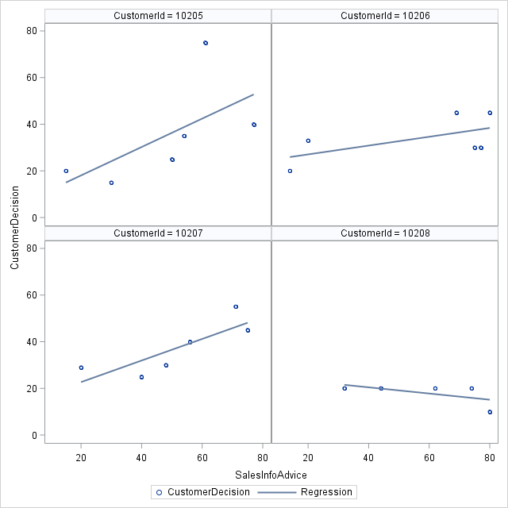
Underlying Cause
Heterogeneity in response: Not all customers are the same !!
Customers can be segmented based on their response

Slide 26
Normality of Error term
Non-normality of error term invalidates p-values
How to check if errors are normally distributed?
Check if residuals “evenly” distributed across observations, close to normal, most within 2 s.d.
Statistical test: Shapiro-Wilk, Kolmogorov-Smirnov
H0: Distribution is normal, HA: Distribution is not normal
Check for outliers: can affect statistical test results
Most common solution: transform dependent variable:
Common transformations are: ln(y) , y^0.5 or 1/y
Notes:
Kurtosis is a descriptor of the shape of a probability distribution
kurtosis is a descriptor of the shape of a probability distribution and, just as for skewness, there are different ways of quantifying it for a theoretical distribution and corresponding ways of estimating it from a sample from a population. Depending on the particular measure of kurtosis that is used, there are various interpretations of kurtosis, and of how particular measures should be interpreted.
The standard measure of kurtosis, originating with Karl Pearson, is based on a scaled version of the fourth moment of the data or population. This number is related to the tails of the distribution, not its peak;^{[1]} hence, the sometimes-seen characterization as "peakedness" is mistaken. For this measure, higher kurtosis is the result of infrequent extreme deviations (or outliers), as opposed to frequent modestly sized deviations.
The kurtosis of any univariate normal distribution is 3. It is common to compare the kurtosis of a distribution to this value. Distributions with kurtosis less than 3 are said to be platykurtic, although this does not imply the distribution is "flat-topped" as sometimes reported. Rather, it means the distribution produces fewer and less extreme outliers than does the normal distribution.
It is also common practice to use an adjusted version of Pearson's kurtosis, the excess kurtosis, which is the kurtosis minus 3, to provide the comparison to the normal distribution. Some authors use "kurtosis" by itself to refer to the excess kurtosis.

Slide 27
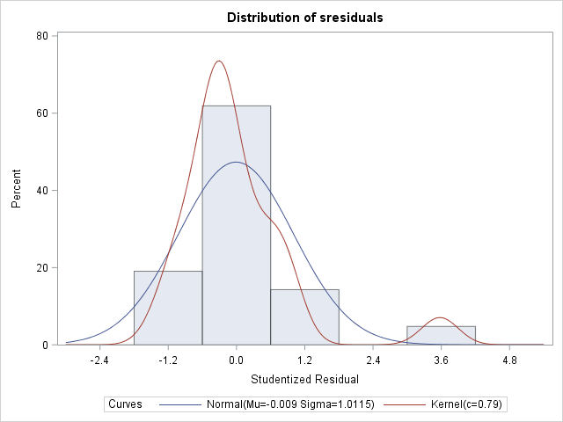
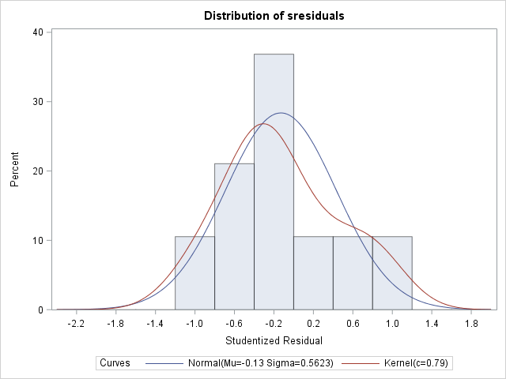
Computer Sales Example
With outliers: Statistical test rejects hypothesis that distribution is normal
Without outliers: Statistical test does not reject hypothesis that distribution is normal

